Slide 1
Flight Delays
R Programming

Slide 2
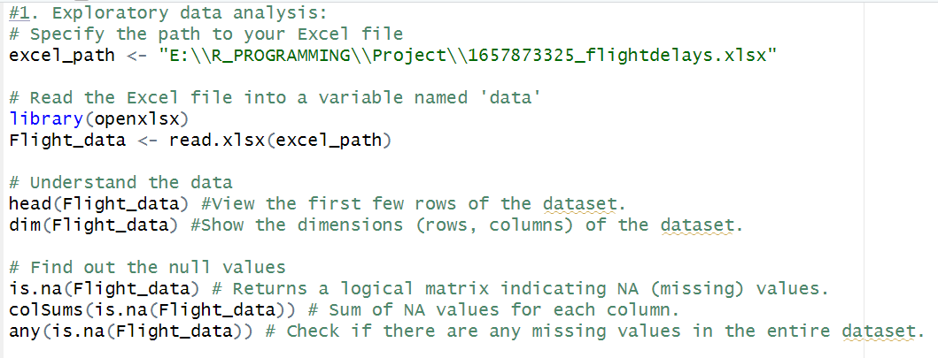
1. Exploratory data analysis: • Read the dataset • Read the dataset description • Understand the data • Find out the null values

Slide 3
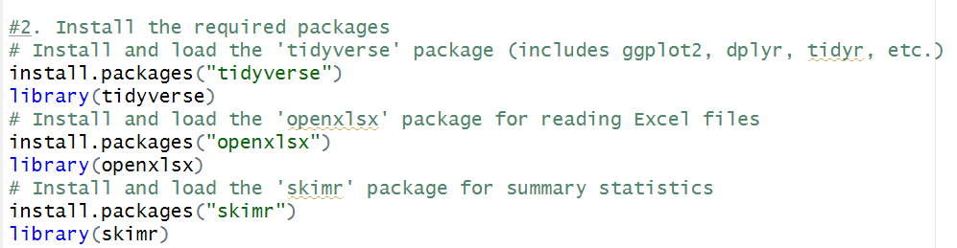
2. Install the required packages

Slide 4
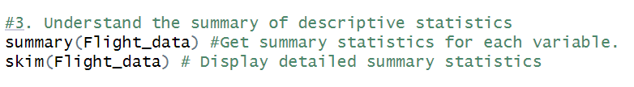
3. Understand the summary of descriptive statistics

Slide 5
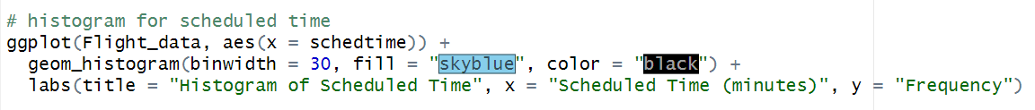
4. Plot the histograms to understand the relationships between scheduled time, carrier, destination, origin, weather, and day of the week
histogram for scheduled time

Slide 6
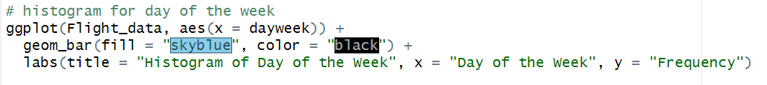
histogram for day of the week

Slide 7
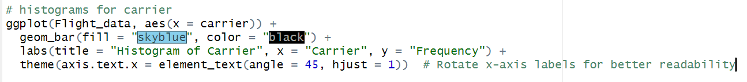
histograms for carrier

Slide 8
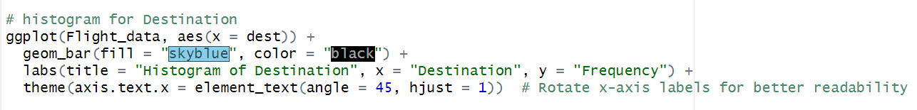
histogram for Destination

Slide 9
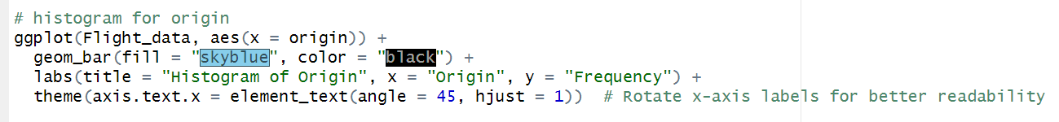
histogram for origin

Slide 10
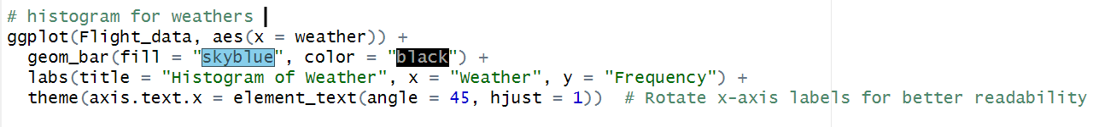
histogram for weathers

Slide 11
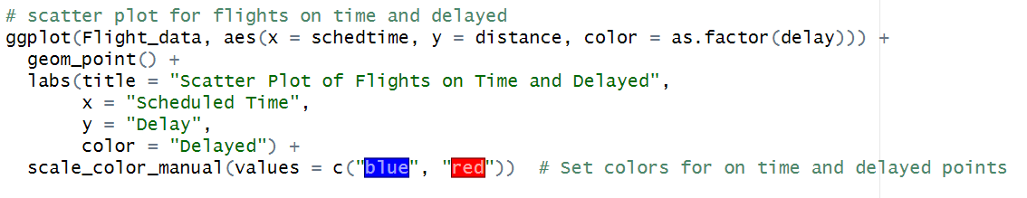
5. Plot the scatter plot for flights on time and delayed

Slide 12
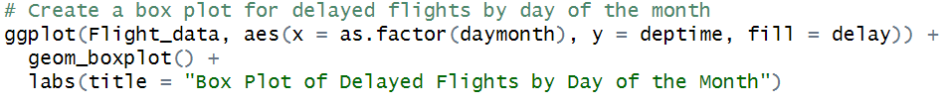
6. Plot the box plot to understand how many days in a month flight are delayed by what time

Slide 13
7. Define the hours of departure

Slide 14
8. Create a categorical representation of data using a table

Slide 15
9. Redefine the delay variables

Slide 16
10. Understand the summary of major variables

Slide 17
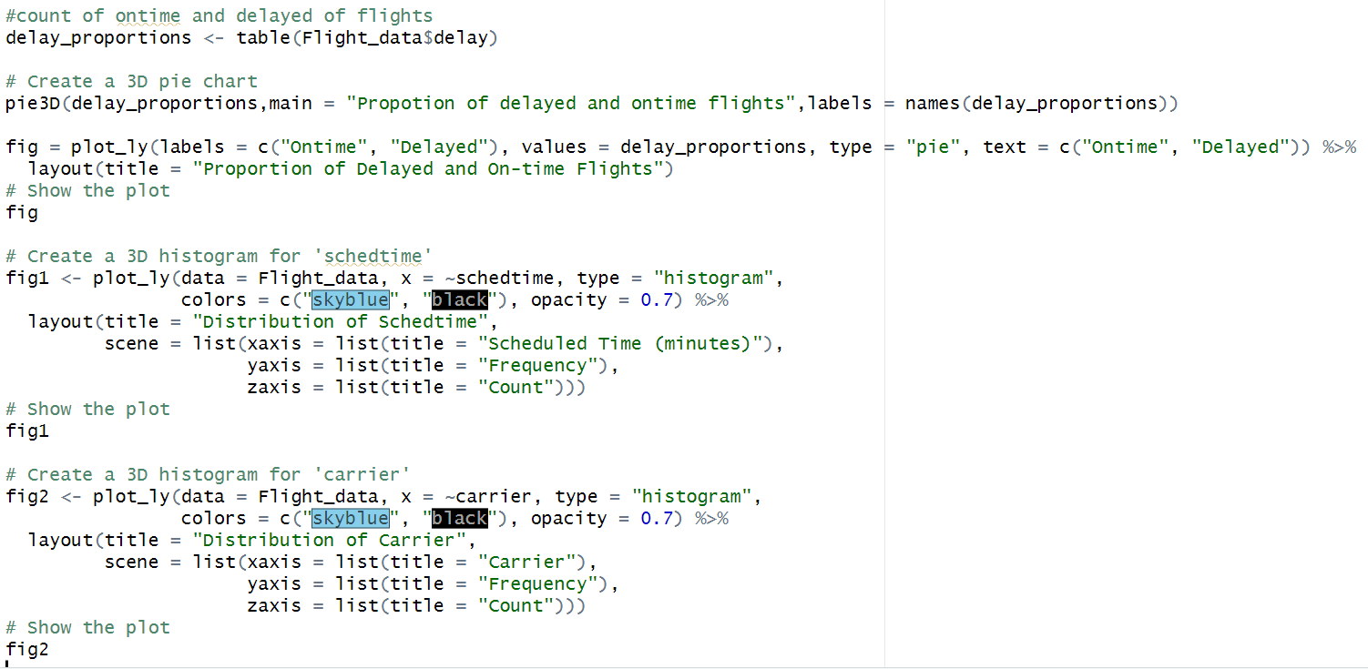
11. Plot histograms of major variables

Slide 18
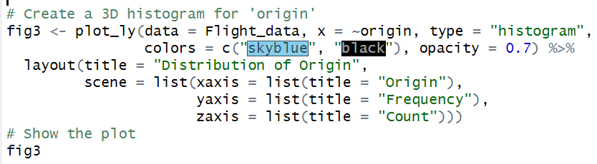
11. Plot histograms of major variables

Slide 19
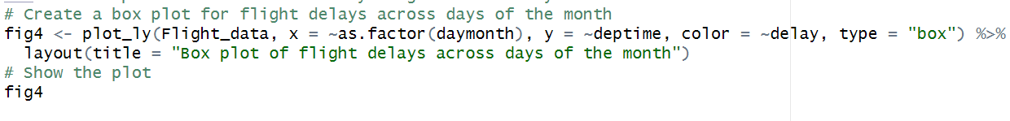
12. Plot a pie chart to see how many flights were delayed

Slide 20
THANK YOU

